Slide 1
The Writing on the Wall:
The Judgment of God and Mankind’s Accountability
Daniel 5:10-23

Slide 2
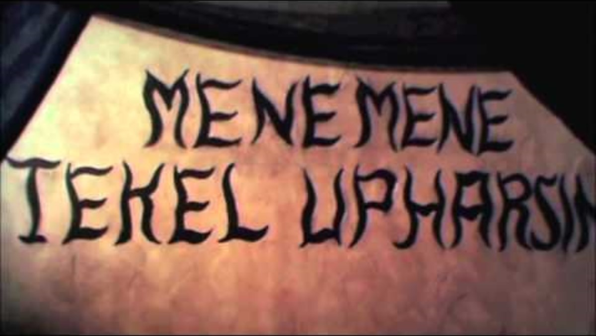
Background and Summary

Slide 3
1. God Uses Unexpected Messengers to Bring Wisdom in Confusing Times (vv. 10-12)
The Queen-mother tells Belshazzar about Daniel.
She had first-hand knowledge about Daniel!
God used her to bring about His will in this situation.
Example #1: Balaam’s Donkey (Numbers 22:21-34).
Example #2: Jonah the Prophet
Lesson: God can and will use anyone He wishes to send His message and bring about His will. He uses even those that the rest of us might not expect.

Slide 4
2. Times of chaos will draw us to God’s wisdom
(vv. 13-16).
Daniel is brought before the king to interpret the writing not because the king respected God, but because of fear.
God uses situations of desperation and fear to force His people to seek Him for deliverance. (Judges 10:10-16)
When we face times of chaos in our lives Jesus offers rest in Him (Matthew 11:28-30).
Even though God must, at times, test His people He also offers comfort and restoration.

Slide 5
3. Stand in the truth with confidence and humility (vv. 17-21).
Daniel refuses to accept the rewards from the king.
He reminds the king of everything God had done to Nebuchadnezzar. These actions serve as a warning both to the king and to us.
All people who have lived, are living now and those who will come are accountable for how they respond to the good news of Jesus.
Scripture provides us with examples of those from the past so that we can learn from them.
We must learn from the mistakes of the past and not repeat them. “Those who refuse to learn history are doomed to repeat it!”

Slide 6
4. Ignoring warnings has consequences (vv. 22-23).
Daniel tells the king that even though he knew all those things, he still chose to dishonor God with his actions.
When warnings are ignored, there are consequences.
All people know that God exists, but they suppress that knowledge in their unrighteousness. Refusing to acknowledge God and living in rebellion does have strong consequences.
King Belshazzar learned this lesson the hard way. The very night he committed this mockery against God was the night he died.

