Slide 1
The Humbling of a Prideful King:
The Dream and Its Interpretation
Daniel 4:4-27
Pastor Jared Smeltzer
1/19/2025
Notes:
Good morning to you all. This morning, we will be looking at the experience that King Nebuchadnezzar had in his life that changed the way that he looked at everything. As we discussed last week, the king is reflecting on a life-changing experience that has rocked the foundations of his previous worldview and has caused him to reevaluate everything he thought that he knew. As we have seen previously in the book of Daniel, God used dreams and visions to communicate what He wanted people to know in this book. The purpose of the dreams and visions were to cause the person having them to seek the wisdom of God and therefore learn the truth that God is sovereign over all the affairs of man and has the authority to put anyone in power that He chooses. With the time we have together today we are going to look at verses 4-27 of chapter 4. In this passage God will be sending a dream for the king to have which will warn him that if he does not change his attitude there will be severe consequences. Then what we will discuss next week is the implementation of the dream and the aftermath of the experience.
DQ: Why is it so difficult for people to give in to authority in their lives?

Slide 2
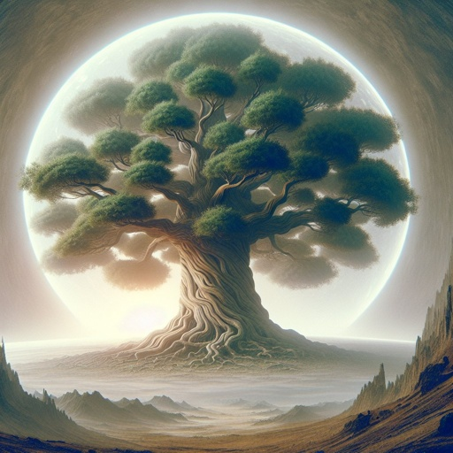
The Dream
The King has a dream, causing him anxiety (vv. 4-7).
Daniel arrives, which brings the king comfort (vv. 8-9).
The tree is big enough to fill the earth and is beautiful (v. 13).
The tree will be cut down, but its root and stump saved (v. 14).
The tree represents the king and his kingdom (v. 15).
The king’s mind will be changed to a wild animal for seven times(v. 16).
God has decreed this until the king admits that He rules all nations! (v. 17)
Notes:
Let us begin by reading together this passage so that we can better understand what is going on. Today we will look at the passage in 2 sections. The first section we will look at are verses 4-18 which provide for us a description of the dream: 4 “I, Nebuchadnezzar, was at ease in my house and happy in my palace. 5 I saw a dream and it startled me; and these appearances as I lay on my bed and the visions in my mind kept alarming me. 6 So I gave orders to bring into my presence all the wise men of Babylon, so that they might make known to me the interpretation of the dream. 7 Then the soothsayer priests, the sorcerers, the Chaldeans, and the diviners came in and I related the dream to them, but they could not make its interpretation known to me. 8 But finally Daniel came in before me, whose name is Belteshazzar according to the name of my god, and in whom is a spirit of the holy gods; and I related the dream to him, saying, 9 ‘Belteshazzar, chief of the soothsayer priests, since I know that a spirit of the holy gods is in you and no secret baffles you, tell me the visions of my dream which I have seen, along with its interpretation.
10 ‘Now these were the visions in my mind as I lay on my bed: I was looking, and behold, there was a tree in the middle of the earth and its height was great. 11 The tree grew large and became strong, and its height reached to the sky, and it was visible to the end of the whole earth. 12 Its foliage was beautiful and its fruit abundant, and in it was food for all. The animals of the field found shade under it, and the birds of the sky lived in its branches, And all living creatures fed from it. 13 ‘I was looking in the visions in my mind as I lay on my bed, and behold, an angelic watcher, a holy one, descended from heaven. 14 He shouted out and spoke as follows: “Chop down the tree and cut off its branches, Shake off its foliage and scatter its fruit; Let the animals flee from under it and the birds from its branches. 15 Yet leave the stump with its roots in the ground, but with a band of iron and bronze around it in the new grass of the field; And let him be drenched with the dew of heaven, and let him share with the animals in the grass of the earth. 16 Let his mind change from that of a human and let an animal’s mind be given to him, and let seven periods of time pass over him. 17 This sentence is by the decree of the angelic watchers, and the decision is a command of the holy ones, in order that the living may know that the Most High is ruler over the realm of mankind, and He grants it to whomever He wishes and sets over it the lowliest of people.” 18 This is the dream that I, King Nebuchadnezzar, have seen. Now you, Belteshazzar, tell me its interpretation, since none of the wise men of my kingdom is able to make known to me the interpretation; but you are able, because a spirit of the holy gods is in you.’”
We have provided for us in this passage a description of the dream that the king had. Let us take a few moments to point out some of the main points provided in his description. In verses 4-7 we have a similar setting to what we had when the king had his previous dreams. He has the dream; it causes him anxiety and then he calls in his wise men to help him figure out what it means. So, in verse 8 Daniel arrives. It’s interesting that the king uses his Hebrew name, but for the sake of his audience he also uses the Babylonian name as well because most likely that is how the people in the kingdom know him. Daniel is said to have the “spirit of the holy gods in him.” This is an interesting point for the king to make about Daniel. Never in his speech does the king give the title of holy gods for the gods of Babylonia. This is understandable because if you have ever read much mythology or stories from polytheistic religions, you will find that the gods in those systems are many times more evil or mischievous than the people they rule over. Nebuchadnezzar is acknowledging that the God of Israel is holy meaning that He has perfect wisdom and is in complete control of the entire universe. We can also note here that Daniel has earned the trust and admiration of the king due to his faithful service to the kingdom over the past few decades. His praise of Daniel continues in verse 9. He knows that Daniel will tell him the truth regarding the dream because he makes the statement that “no secret baffles you.” There is no concern that Daniel will tiptoe around the issue or try to change the message to comfort the king. Therefore, the king is ready to share the dream with Daniel and accept what it means.
Now let’s look at the description of the dream. We have a large tree that is so large that it reaches the highest part of the sky. The tree is in the middle of the earth, and it could be seen from every spot over the entire earth. Its beauty was great because it was filled with fruit, birds nested in the branches and the king said the foliage was beautiful. This was a gorgeous tree which was being enjoyed by everyone on the earth. In verse 13 a new character appears in the dream, which the king refers to as a watcher. This refers to an angel who is part of the holy council in heaven and who had the responsibility to watching over the affairs of man. This angel has the responsibility in this dream to bring to the king the judgment of God and to inform him what was going to happen in the future. Starting in verse 14 the watcher pronounces God’s judgment. The tree is going to be cut down, with a stump left as well as the roots still being deeply rooted in the soil. The stump will be protected by a fence around it made of iron and bronze.
Then, beginning in verse 15 we see “him” being used telling us that this tree represents a person, who we end of knowing will be the king. His judgment includes a few important details: first, he will live with the animals on the earth, his mind will begin to be like an animal, and this will take place for a specific period. The judgment has been determined by the holy council of God and the purpose is to remind the king of God’s sovereignty over all the things that happen on this earth. Then we conclude with the king repeating his trust in Daniel as being the one with the ability to interpret the dream.

Slide 3
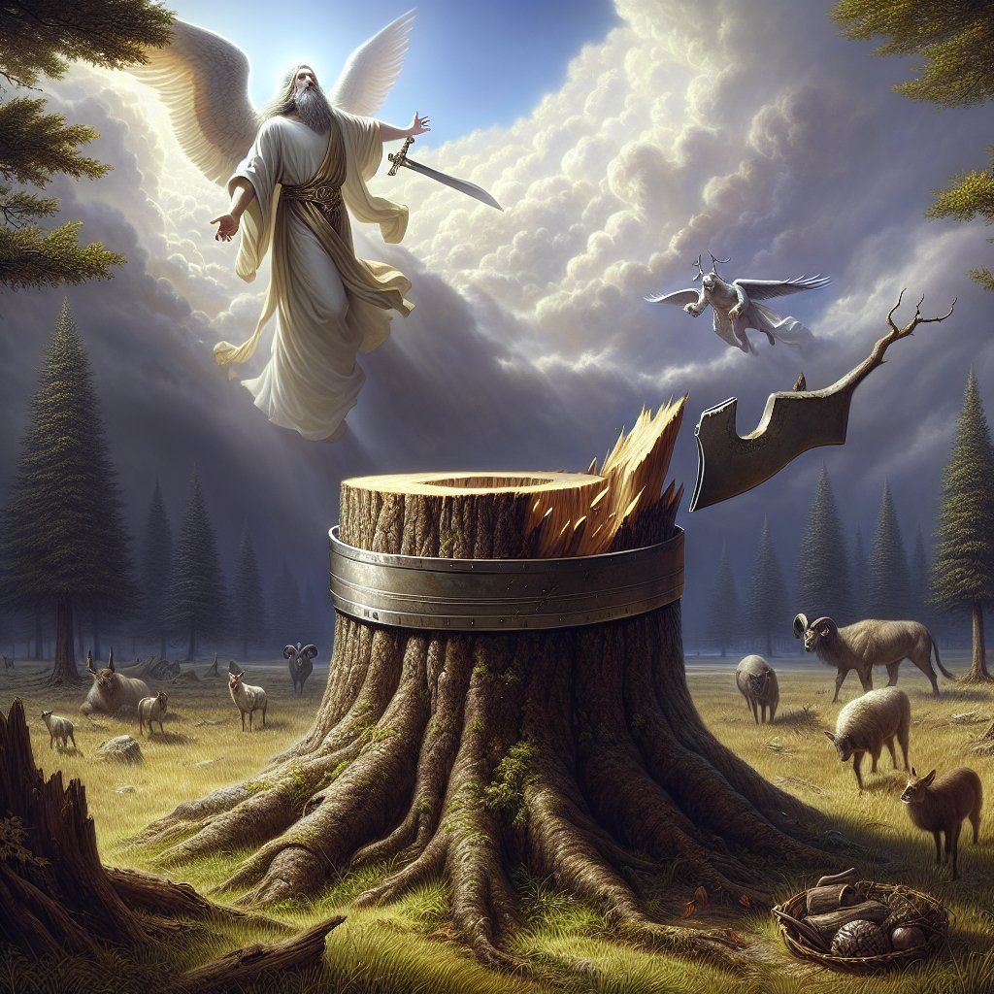
The Interpretation
Daniel pauses before telling the king the meaning because it appalled him (v. 19).
Daniel says he wished the dream was for his enemies, not him (v. 19).
The stump remaining means the kingdom will be restored (v. 26).
Seven times means this will take place over a seven year span (v. 25).
Kingdom will be restored when the king acknowledges God (v. 26).
The king has time to repent so that he might escape this judgment (v. 27).
Notes:
Now that we have the basic description of the dream, let’s read together verses 19-27. “19 Then Daniel, whose name is Belteshazzar, was appalled for a while as his thoughts alarmed him. The king responded and said, ‘Belteshazzar, do not let the dream or its interpretation alarm you.’ Belteshazzar replied, ‘My lord, if only the dream applied to those who hate you, and its interpretation to your adversaries! 20 The tree that you saw, which became large and grew strong, whose height reached to the sky and was visible to all the earth, 21 and whose foliage was beautiful and its fruit abundant, and in which was food for all, under which the animals of the field lived and in whose branches the birds of the sky settled— 22 it is you, O king; for you have become great and grown strong, and your majesty has become great and reached to the sky, and your dominion to the end of the earth. 23 And in that the king saw an angelic watcher, a holy one, descending from heaven and saying, “Chop down the tree and destroy it; yet leave the stump with its roots in the ground, but with a band of iron and bronze around it in the new grass of the field, let him be drenched with the dew of heaven, and let him share with the animals of the field until seven periods of time pass over him,” 24 this is the interpretation, O king, and this is the decree of the Most High, which has come upon my lord the king: 25 that you be driven away from mankind and your dwelling place be with the animals of the field, and you be given grass to eat like cattle and be drenched with the dew of heaven; and seven periods of time will pass over you, until you recognize that the Most High is ruler over the realm of mankind and bestows it on whomever He wishes. 26 And in that it was commanded to leave the stump with the roots of the tree, your kingdom will remain as yours after you recognize that it is Heaven that rules. 27 Therefore, O king, may my advice be pleasing to you: wipe away your sin by doing righteousness, and your wrongdoings by showing mercy to the poor, in case there may be a prolonging of your prosperity.’”
Now we will look closer at the interpretation provided by Daniel. To make this a bit faster we will look at these main parts of the interpretation:
• Before Daniel provides the interpretation for the king, we are told in verse 19 that he paused because he was appalled at what he was going to have to tell the king. The king, seeing the way Daniel had responded, then tells Daniel not to fear to tell him what the dream means regardless of the message.
• Daniel tells the king before the interpretation that he wished that the dream was meant for his enemies rather than him. By saying this we see that Daniel respected and has come to care for the king. Therefore, we see that both Daniel and the king have a strong relationship. The news for the king is not good!
• The tree which is so large and beautiful represents King Nebuchadnezzar. His kingdom was so large that it took up the whole earth, the people of the world enjoyed its shade and its beauty.
• Since he is the tree, when the angel pronounces that the tree is to be cut down, but that the stump will remain with the fence of iron and bronze means that his kingdom will be taken away from him for a time, but that when he returns the kingdom will be restored to him.
• The king will be given the mind of a wild animal and will be in that state for seven periods. What does the angel mean by saying that this will happen over a period of seven times? What the angel is saying is that seven years will pass before the king comes back to his senses. This phrase is also used in Daniel 7:25 and in that context times also means years.
• When the king returns to sanity and then acknowledges the sovereignty of God this is when God will restore his kingdom to him. He must acknowledge that God is the sovereign ruler over all the kingdoms of man, and He institutes those into power whom He chooses. Once the king admits this truth his kingdom will be restored to him.
• Not only must the king make this statement of faith, but Daniel also gives the king some very powerful advice. He tells the king that he must change his arrogant attitude, share his wealth with the poor and accept the judgment of God. By doing this Daniel is hoping that the king will be able to prolong his days of ruling over the kingdom and that God might show him mercy.

Slide 4
Applications
In our lives it is easy to allow the times of comfort and peace to make us get a big head and think we have done it all on our own! That is not true! Every good and perfect gift comes from God (James 1:17).
God is patient and kind. He will allow us to repent of our sin of pride, but if we don’t then we will face consequences. (1 Peter 5:6-7)
No matter how much success or prosperity we may have in life, we must acknowledge that all of it happens because of God. We must answer to God for all that He has blessed us with. (Psalm 24)
Notes:
Wow, that was quite a bit of material to get through. We have reached the end of our analysis of the scripture, now it is time for us to see what this dream might mean for us. We will take the next few moments to discuss a few applications so that we may practice the lessons we are learning in today’s passage:
• Our first application comes verse 4. When the dream came to the king he was living a good life in his palace. He was very comfortable and enjoying a time of peace in the kingdom. In our lives it is easy to allow the times of comfort and peace to make us get a big head and think that we have all those comforts and peace because of our own abilities. We must not allow our heads to get filled up with arrogant pride when things are going the way we want them to go. We must always remember that every good and perfect gift comes from above (James 1:17) and that we only have the things we do because the Lord has allowed us to have them.
• Our second application comes from verse 27 where Daniel advises the king to repent of his arrogant attitude. God will judge those who remain prideful, but He will give grace to those who remain humble and who acknowledge Him for his mercy. (1 Peter 5:6-7). What this teaches us about God is that He is patient and kind. Even though He must judge evil and make certain that all sins are punished, He still allows people to repent of that sin, place their trust in Jesus Christ for salvation and walk in a newness of life. (Romans 6:4)
• Our third application is that no matter how many times we might experience success or prosperity we cannot forget that we still are subjects of the heavenly kingdom and that we answer to God for the ways that we use all the things He has blessed us with. The Psalmist in Psalm 24 reminds us of this truth. Please read the 24th Psalm with me: “The earth is the Lord’s, and all it contains, The world, and those who live in it. 2 For He has founded it upon the seas and established it upon the rivers. 3 Who may ascend onto the hill of the Lord? And who may stand in His holy place? 4 One who has clean hands and a pure heart, who has not lifted up his soul to deceit and has not sworn deceitfully. 5 He will receive a blessing from the Lord and righteousness from the God of his salvation. 6 This is the generation of those who seek Him, Who seek Your face—even Jacob. 7 Lift up your heads, you gates, and be lifted up, you ancient doors, that the King of glory may come in! 8 Who is the King of glory? The Lord strong and mighty, The Lord mighty in battle. 9 Lift up your heads, you gates, And lift them up, you ancient doors, That the King of glory may come in! 10 Who is this King of glory? The Lord of armies, He is the King of glory.”
As we conclude our time together let us learn from the example of King Nebuchadnezzar. When we experience success or prosperity let us not forget where all those gifts come from. God is sovereign over all men and therefore is the One who has allowed us to enjoy this life. May we never cease to give Him praise for His marvelous deeds and His powerful wonders He continually shows.

