Slide 1
The Humbling of a Prideful King: Implementation of the Dream and the Aftermath
Daniel 4:28-37
Notes:
Good morning church family! This morning, we will be concluding chapter 4 of Daniel by looking at the way that God followed through implementing the dream that we looked at last week and what the King of Babylon will share with his readers as he processes what has happened to him. As we said last week the main idea of the book of Daniel is provided for us in chapter 4 verse 25 which says that God is “ruler over the realm of mankind and bestows it on whomever He wishes.” We have learned so far in our studies of this book that God is sovereign over all the affairs of man and has the power to put into authority anyone He chooses. With this being true man must be willing to acknowledge his position on the earth and be humble enough to accept God as being the ultimate authority. Whenever mankind does not do so that is when things can become very wild and spiral out of control. This is what is about to happen to the king. He has been warned through the dream as well as the interpretation provided by Daniel, but as we will see that warning is going to be ignored because the king is so infatuated with pride that he is unwilling to listen. Our passage of study today is chapter 4 verses 28-37. Let’s read this to help us become familiar with the setting:
28 “All of this happened to Nebuchadnezzar the king. 29 Twelve months later he was walking on the roof of the royal palace of Babylon. 30 The king began speaking and was saying, ‘Is this not Babylon the great, which I myself have built as a royal residence by the might of my power and for the honor of my majesty?’ 31 While the word was still in the king’s mouth, a voice came from heaven, saying, ‘King Nebuchadnezzar, to you it is declared: sovereignty has been removed from you, 32 and you will be driven away from mankind, and your dwelling place will be with the animals of the field. You will be given grass to eat like cattle, and seven periods of time will pass over you until you recognize that the Most High is ruler over the realm of mankind and bestows it on whomever He wishes.’
33 Immediately the word concerning Nebuchadnezzar was fulfilled; and he was driven away from mankind and began eating grass like cattle, and his body was drenched with the dew of heaven until his hair had grown like eagles’ feathers and his nails like birds’ claws. 34 “But at the end of that period, I, Nebuchadnezzar, raised my eyes toward heaven and my reason returned to me, and I blessed the Most High and praised and honored Him who lives forever; For His dominion is an everlasting dominion, And His kingdom endures from generation to generation.
35 All the inhabitants of the earth are of no account, But He does according to His will among the army of heaven and among the inhabitants of earth; and no one can fend off His hand or say to Him, ‘What have You done?’
36 At that time my reason returned to me. And my majesty and splendor were restored to me for the honor of my kingdom, and my state counselors and my nobles began seeking me out; so I was reestablished in my sovereignty, and surpassing greatness was added to me. 37 Now I, Nebuchadnezzar, praise, exalt, and honor the King of heaven, for all His works are true and His ways just; and He is able to humble those who walk in pride.”
As we look more closely at this passage, one of the first things that really jumps out is that the passage begins in the first person meaning that the king is recounting the experience himself. Then, in verse 33 we see that this transitions to third person meaning that Daniel most likely wrote this section because the king was driven away and was not in his right mind during that time. Then, once again in verse 36 it transitions back to a firsthand account. Therefore, this passage speaks of the life-changing experience by the king from both his own perspective as well as those who witnessed him during his time of judgment.
In verses 28-30 the setting is provided for us. Everything we are about to discuss took place with the king just as the dream had foretold. This took place one year after the dream had been given to the king as well as the interpretation by Daniel. God, therefore, gave the king one year to take seriously the warning He had given him in the dream and possibly change his course of action. We see that the king still did not take the warning of God seriously and chose rather to continue in his prideful ways. In verse 30 we see what the king was so prideful in and why he had such a big head. He says in the verse that Babylon is great, that he built it all by himself using his own power and he built it to show off his majestic power. Before moving on, I would like to share with you why the king had such arrogance and thought his kingdom was so great. According to the Greek historian Herodotus, this is what the city of Babylon was like which was raised by Nebuchadnezzar. The city was “in the form of a square, 14 miles on each side, and of enormous magnitude. The brick wall was 56 miles long, 300 feet high, 25 feet thick with another wall 75 feet behind the first wall, and the wall extended 35 feet below the ground. 250 towers that were 450 feet high. A wide and deep moat that encircled the city. The Euphrates River also flowed through the middle of the city. Ferry boats and a ½ mile long bridge with drawbridges closed at night. Hanging gardens (one of the wonders of the ancile world) and water was raised from the river by hydraulic pumps. Eight massive gates that led to the inner city and 100 brass gates. Streets were paved with stone slabs 3 feet square. The Great Tower (Ziggurat) and 53 temples including the ‘Great Temple of Marduk.’ 180 altars to Ishtar. Golden image of Baal and the Golden Table (both weighing over 50,000 pounds of solid gold.) And 2 golden lions as well as a solid gold human figure (18 feet high).” Using this description gives us just a taste of what the city of Babylon was like. The beauty of this city was coveted by all the other nations of the world and caused the king to think high of himself. Let’s watch this short video which will take us through the city as described by the historian.

Slide 2
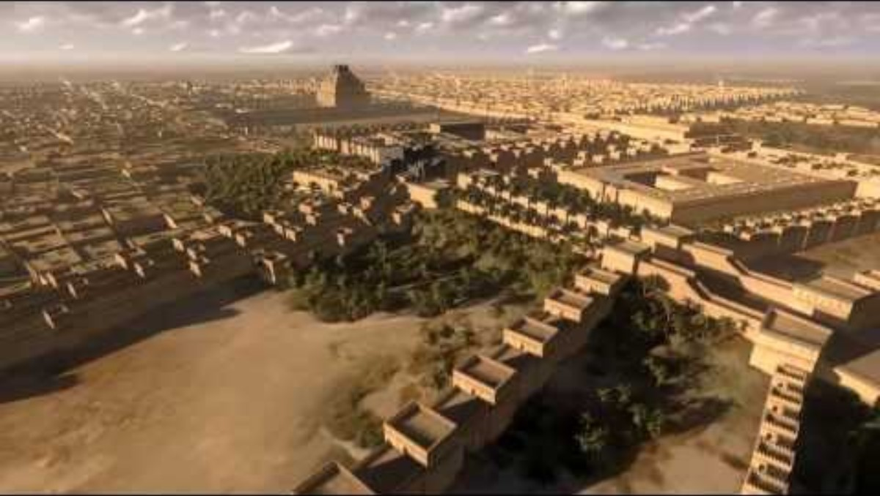

Slide 3
Implementation of the Dream
“Physically he became like the brute beast he imagined himself to be, as his skin toughened into hide through constant exposure to outdoor weather at all seasons (the temperature in modern Iraq ranges from a high of 110 or 120 degrees Fahrenheit in summer-usually with high humidity- to a low of well below freezing in winter). Most particularly the hair of his head and his body, becoming matted and coarse, looked like eagle feathers; his fingernails and toenails, never cut, became like claws.”
(The Expositor’s Bible Commentary. Vol. 7., p. 66).
Notes:
So, as all of us have seen, the king of Babylon did have a beautiful city, making him develop a very large ego. He was so proud of his kingdom that he wanted everyone to know that he was the architect of it and that it was by his own power that it had been established. Verse 31 tells us that while he was still praising himself there came a voice from heaven pronouncing that the judgment was about to begin. The voice echoes what the watcher said in the dream he had over a year before. He would be driven away from man and have the mind of an animal. He would live with the other animals, eat grass like them, be exposed to the elements of the weather and be in this condition for the seven years, which at the end of that time he would look to heaven and acknowledge the sovereignty of God. By the time we reach the end of verse 33 this judgment had been carried out. In verse 33 we have provided for us a description of what the king looked like before this all had been fulfilled. We are told that his body was wet with the dew of heaven. One thing that we need to take into account as we read the passage is the climate of the Iraq region. The theologian Gleason Archer provides for us a description of what the king looked like after this ordeal:
Physically he became like the brute beast he imagined himself to be, as his skin toughened into hide through constant exposure to outdoor weather at all seasons (the temperature in modern Iraq ranges from a high of 110- or 120-degrees Fahrenheit in summer-usually with high humidity- to a low of well below freezing in winter). Most particularly the hair of his head and his body, becoming matted and coarse, looked like eagle feathers; his fingernails and toenails, never cut, became like claws (The Expositor’s Bible Commentary. Vol. 7., p. 66).
Therefore, the king looked like a wild animal that had been exposed to the elements over a period of seven years. I can understand how hard it would have been for the people in the kingdom to see the king looking and acting this way. Like we have said before, this was something that the whole kingdom would have been aware of, so the king is sharing this account with the people to set the record straight.

Slide 4
The Aftermath
The king acknowledges the sovereignty of God.
God has an everlasting dominion.
His kingdom lasts from generation to generation.
All people on the earth are under His authority.
He does whatever He wills.
No one has the power to resist His will.
Notes:
We now reach verse 34 the king is at the end of his seven years of judgment and is now looking to heaven and acknowledging the sovereignty of God. He tells the reader that his sanity has now returned, and he is fully aware of what had happened to him during this time. Verse 35 then is a restatement of what the king has provided to his readers at the beginning of chapter 4 when he says that God has an everlasting dominion, that His kingdom lasts from generation to generation, that all people on the earth are under His authority, that He does what He wills and finally that no one has the power to resist His will. By making all of these statements the king has essentially stated that he now accepts the sovereignty of God and is aware of the power that God has to carry out His will among the inhabitants of earth.
As the fourth chapter of Daniel concludes, the king recounts that his kingdom was restored to him after the judgment had been carried out. Not only was his kingdom restored, but his greatness as king had increased. God made certain that this king was able to serve his final year as the monarch with an added amount of greatness and splendor. As we will be discussing in a few moments, this grace and kindness shows us the kind of God we serve. The last verse recounts that the king now understands that those who walk humbly before God are the ones who are exalted. Now that we have reached the end of our analysis of the passage, let’s turn our attention to the lessons this passage teaches us that we can apply to our own lives.

Slide 5
Application
We need to guard our hearts against pride. We do all things through the power of God.
God has the final authority over our lives, so we must submit to His will in all things.
There are many benefits of living a life in humble service to God. Freedom from the curse of sin and we can lead others to saving faith in God!
Notes:
Our first application today has to do with pride. We as followers of Christ need to constantly be on guard against the sin of pride. Guarding our hearts means that we need to always remember the position that God has placed us in. We are children of the Father of heaven who has created us for the purpose of glorifying Him and making Him known to creation. If we spend most of our time glorying in our own achievements and always try to make others see how marvelous we are then we are wasting the opportunity we have to point others to the God, we serve who is so much greater than us and has made everything we have possible. When we take pride in ourselves, we are stealing glory from the God who made us. Rather than bask in our own achievements we need to glorify our Creator because it is through Him that we can accomplish all things. When the Apostle Paul was serving time in prison due to his testimony regarding Jesus Christ, he was quick to tell others not to speak highly of him or give him the glory for the things that had taken place. In Philippians 4:13 he provides words for his readers that are familiar to all of us “I can do all things through Him who strengthens me.” Paul was facing persecution because of his faith. He realized that the only reason he was able to face those times of trial was because God gave him the strength to face it. This also rings true with the times we enjoy success. We can only enjoy those times because God has allowed us to experience them. May we always give God the credit for those times in our lives when we prosper.
Our second application we can take from the king’s experience in chapter 4 is to remember that God has authority in all aspects of our lives and that we need to submit to His will in all things. One of the hardest aspects of the Christian life to explain to a non-believer is why a follower of Christ submits to the words of Scripture. We live in a world where the predominant belief is that each person is in control of their own life and therefore, they can make any decision they want and do whatever they please because they do not answer anyone else but themselves. This is the little god complex that has taken over society. All of us, if we were left to our natural condition, want to be in control of our own lives. However, when someone comes to faith in God through Jesus Christ the desire to be in control melts away and the humility to follow God’s word takes over. This happens because Christ comes in and takes over the pride that had once dominated our hearts. The Apostle Paul, in his letter to the Galatians, tells them that Christ had taken over his entire life and he was now living his life through the power of God. “I have been crucified with Christ; and it is no longer I who live, but Christ lives in me; and the life which I now live in the flesh I live by faith in the Son of God, who loved me and gave Himself up for me” (2:20). This verse is so powerful because it shows us the power of God to change anyone who comes in faith seeking to be His child. The old man is crucified with Christ and now the new life lived out in obedience to Christ not because of a need to earn God’s favor, but as Paul tells us this new life is being lived out as appreciation because Christ loved us and gave His life to save us from the curse of sin. Surrendering to the authority of God is not something that we do out of obligation, rather it is something we do because we understand that our position with God has been purchased through the blood of Christ. Our relationship with God has been restored, so now we can walk in humility before Him and do so by allowing Him to be the Lord of our lives.
Finally, our third application shows us the benefits of living a life in humble service to God. When we choose to lay down our own personal glory and place our trust in Christ for salvation, we are immediately rewarded with the curse of sin being removed from us. This gift allows us to have the blessed assurance that we will one day be able to stand in the presence of holy God with the blood of Christ cleansing us from our sin. Just as we read together a couple weeks ago from the first epistle of John, “if we walk in the Light as He Himself is in the Light, we have fellowship with one another, and the blood of Jesus His Son cleanses us from all sin” (1 John 1:7). What we learn is that there is an eternal reward for living a life of humility under the authority of God. Now, are there any rewards in this present life for those who walk humbly before God? Yes, there are rewards as well. One of the greatest rewards for humility is the power that our testimony can have in the lives of others. Being a humble follower of Christ does not guarantee financial prosperity or perfect health, but when someone lives as a humble follower of Christ and gives Him the glory in all circumstances that person provides an encouraging example to others which can lead them to a saving faith in God as well. The way we live is watched carefully by others, so let us live in a way that our lives point others to Jesus Christ. The best gift we can share with anyone is the truth of the gospel because it is through that truth that anyone who places faith in Christ may be saved.
In conclusion, as we wrap up chapter 4 of the book of Daniel let us continue to challenge one another to practice humility in our lives, make God’s will the priority in our lives and acknowledge that all things that happen in this life are because of the sovereignty of God. When we are willing to let go and allow our God to be in control, we can live out our faith in confidence knowing that in all things our God is holy, just and always does what is right. King Nebuchadnezzar learned this lesson the hard way. May we learn this lesson through his example, and may our lives give glory to the Lord who has given us every good and perfect gift. Amen.

