Slide 1
Christ, the Eternal King!
Daniel 2:31-45

Slide 2
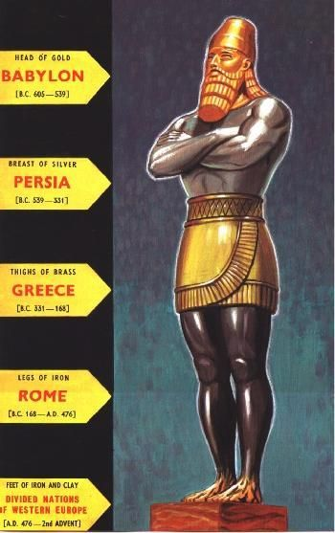
King nebuchadnezzar’s dream
The Image: In the king’s dream he saw a statue. It was described as being large, had extraordinary radiance and was awesome!
It’s head was made of gold: Kingdom of Babylon.
Chest and arms of silver: Kingdom of Medo-Persia.
Thighs of Bronze: The Greek Empire.
Legs of Iron: The Roman Empire.
Feet of iron and clay: 10 other kingdoms that would exist after the fall of Rome.

Slide 3
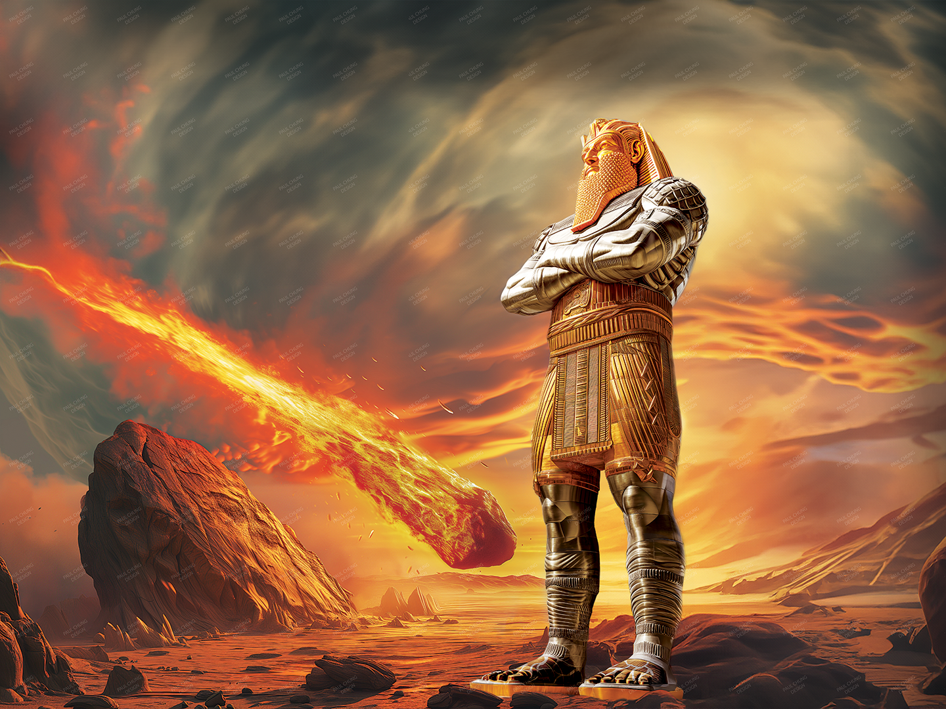
Christ’s kingdom: the stone
The stone represents the Kingdom of God:
1. It was cut without human hands: The Lord Jesus Christ was not created. He is eternally begotten of the Father. He has always existed with God (John 1:1-3).
2. It was so powerful it destroyed the statue. When Christ returns, He will defeat all of the kingdoms (Luke 1:32-33 and Revelation 11:15).
3. The stone fills the entire earth. Christ will rule all of the earth during His millennial reign. (Matt. 24:14, Habakkuk 2:14 and Revelation 20:1-6)

Slide 4
We can trust in god!
Why can the King of Babylon trust Daniel’s interpretation? Here are three reasons why:
1. The God of heaven is in control of all things in this world! (Psalm 115:3, 135:6)
2. We continually see around us that things in this world are getting worse every day, meaning more ungodly. (2 Timothy 3:13) We must not lose hope! Christ will bring restoration.
3. We are also seeing kingdoms of this world failing. With the downfall of mans kingdoms will come the eternal kingdom of Christ. When Christ returns, He will bring His reward with Him. Those who trust in Him will be in His presence forever!

